Slide 1
Planning Your Future
Junior Class Presentation

Slide 2
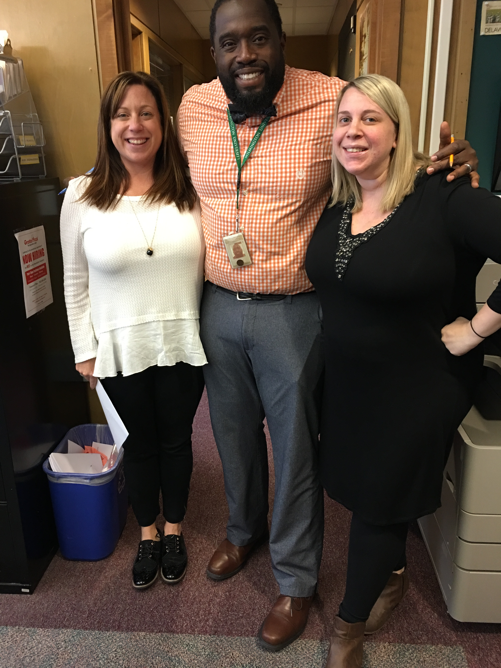
Your School Counselors
Ms. Herskowitz
Last Names A-F
Mrs. Bereskin
Last Names G-O
Mr. Turner
Last Names P-Z

Slide 3
Graduation Requirements

Slide 4
Promotion to the 12th grade
18 Credits Required to be Promoted!
3 English
3 Math
3 Science, or Social Studies, or World Language
9 Additional Credits
Credits are earned when you pass a class with a D (60%) or higher!
Ask for help from your teachers if you are struggling in any of your classes!
Earn Additional Credits!: You can earn an elective credit by completing 90 hours of community service and a summer work credit by working 150 hours over the summer

Slide 5
It’s Time to Start Thinking About Life After MPHS…….
College- 4 or 2 year
Trade School
Military
Employment
There is no right or wrong answer as long as you have a plan!

Slide 6
What are you looking for in a post-secondary school?
Location / Environment
Academic Program
Housing
Athletics / Extracurricular Programs
Academic Support Services
Study Abroad

Slide 7
What are Colleges looking for?
Challenging high school courses (also in senior year!)
GPA
Rank
SAT/ACT Scores
Extracurricular Activities
The “Wow” factor – something special about you….

Slide 8
Researching Colleges
Reach Schools – long shot
Middle Reach Schools - maybe
Safety Schools - definitely
Check out the average SAT scores and GPAs of universities/colleges on www.bigfuture.org!
Also visit DelawareGoestoCollege.org

Slide 9
Paying For College
Federal Money (FAFSA)
Need-based / Merit Scholarships
Educational Loans
Savings
Work-Study

Slide 10
Scholarship Opportunities for Delaware Students
SEED Scholarship: Keep your GPA above 2.5 and you will be eligible for free college tuition at Del Tech or University of Delaware’s Associates of Arts Program.
Inspire Scholarship: Keep your GPA above 2.75 and you will be eligible for free tuition at Delaware State University.

Slide 11
School Day SAT
April 5th, 2017
Create an account on:
collegeboard.org
You can also view your PSAT score!
DOE will be registering all 11th Grade Students
FREE practice tests and test prep at collegeboard.org and khanacademy.org

Slide 12
Email Address
Your email address should be appropriate for distribution.
Most college applications will be done on-line; therefore, a professional email address is essential.
Be aware of your social media image!

Slide 13
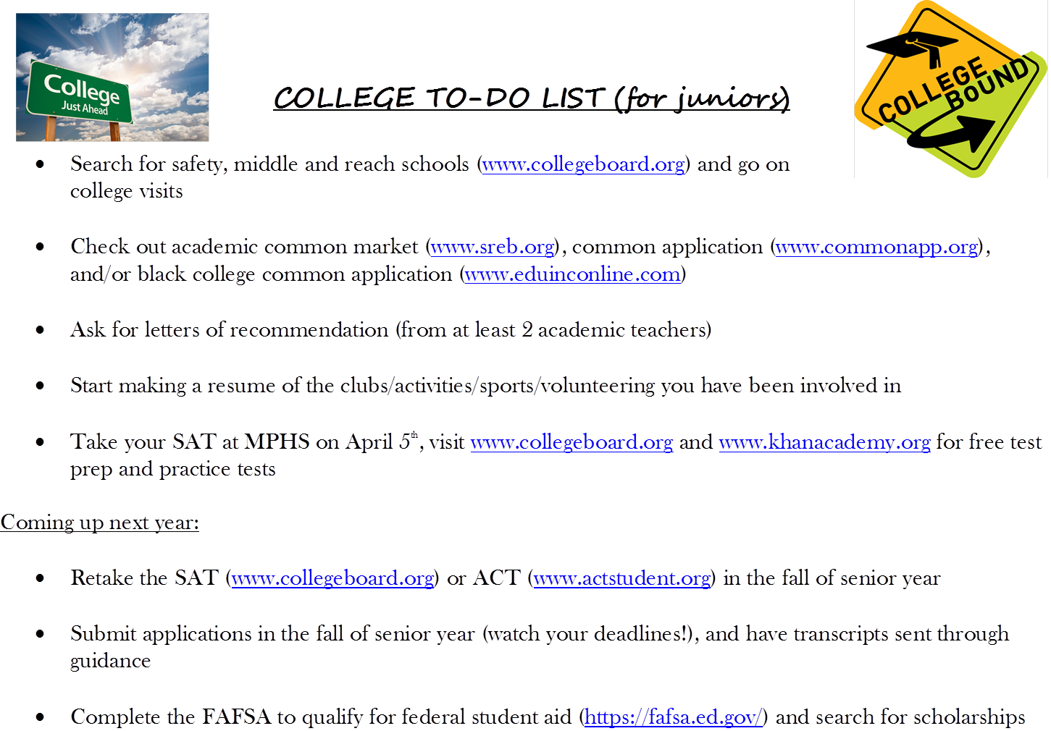

Slide 14
Questions????

